Slide 1

PROJECT
Computer Science & Engineering
Title : REAL TIME DRIVER DROWSINESS DETECTION USING VISUAL BEHAVIOUR
Supervisor : T. JAYA SRI DEVI
Team Members :
20951A05P1 - B VARUN TEJA 20951A05P0 - E VARUN KUMAR 20951A05K1 - P SOHAN

Slide 2

OUTLINE
Introduction
Project Overview
Objective
Design & Methodology
Design and Implementation
Results

Slide 3

INTRODUCTION
In the current state, everyone is busy with their works and they forget to take care of their health. Health does not stop at being fit. It also includes proper sleep. Sleeping is an important job every human must do every day to maintain his/her health.
It is a natural phenomenon that cannot be avoided at all. But, sleeping while driving is not the proper way. Hundreds of people use the road to travel and it could lead to unexpected events to occur. Accident due to drowsiness is one of the main factors for the accident on roads. This could also be caused due to drivers' negligence and carelessness to the road. These accidents not only affect the driver also the vehicles coming next to it.
Drowsing while drive doesn't only harm us it also hams our surroundings: our nearby vehicle is affected by our carelessness. Currently in hurry people avoid taking proper sleep. This leads to all the problems.

Slide 4
OBJECTIVE
Specific objectives include:
The primary objective is to develop a system that can accurately detect driver drowsiness in real-time. This involves analyzing various visual cues, such as eye closures, head movements, yawning, or changes in facial expressions, to determine the driver's level of alertness.
The system aims to provide timely and proactive warnings with alarm-sounds to drivers before they become excessively drowsy or fatigued..
Achieving high accuracy in detecting driver drowsiness is crucial.
The system aims to have a webpage that is automatically redirected to a list of nearby hotels and motels when the driver is detected to be drowsy frequently.
It can also be beneficial to have a fail-safe mechanism that alerts the driver's contacts if the driver becomes drowsy frequently.

Slide 5

METHODOLOGY
The solution for driver drowsiness detection using Python is to utilize a combination of facial landmark detection and eye tracking.
This solution involves using a live model to detect facial landmarks, such as the eyes and mouth. Then, by monitoring the position and movement of the eyes, the system can detect signs of drowsiness, such as drooping eyelids or longer blinks.
This solution can be implemented using the OpenCV computer vision library in Python.

Slide 6
METHODOLOGY(cont)
The camera will be placed in front of the driver to take a snapshot of his face. By using this camera, we take images of the driver.
After the face has been recognized, with the use of dlib package, we can plot landmarks on the detected face. Here, a facial landmark means the location of the eye and mouth, etc.
From the eye landmarks EAR value and from the mouth landmarks MAR value are calculated. Then compare these values with the threshold values of EAR and MAR.
If the maximum successive frames exceed the thresholds of the EAR and MAR means the driver is drowsy, then the driver will receive a warning and SMS messages will be sent to the passengers.

Slide 7
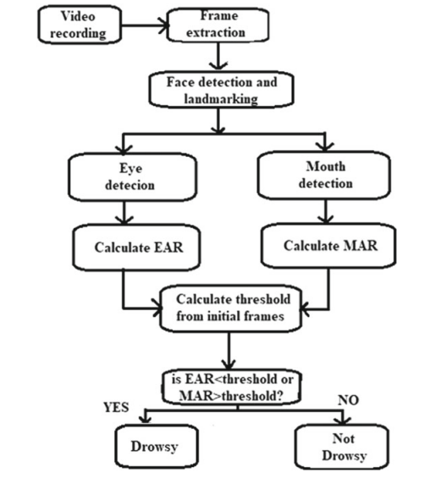
DESIGN

Slide 8
IMPLEMENTATION
Data Collection:
First, we can install a camera in the vehicle and use it to record a video of the driver. OpenCV mainly focuses on capturing the video. We may collect the frames from the video that are used to identify the driver’s current state, i.e. drowsy or not.
B. Face Detection:
Haar Cascades Algorithm:
Haar Cascades are a popular method for face detection and are implemented in OpenCV. They use a series of simple features to identify objects (in this case, faces) in an image. Haar Cascades are efficient and work well in real-time applications.

Slide 9
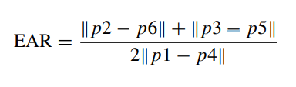
IMPLEMENTATION
Facial Landmark Marking:
We can acquire the 68 landmark points of the face by using the dlib package. we utilize the range between image pixels to identify the eyes and mouth in a facial image . According to the image, the right eye is located from 37 to 42, the left eye is located from 43 to 48, and the mouth is located from 49 to 68.
Blink Rate and Yawn Count Calculation :
The EAR is the ratio of the distance between vertical eye landmarks to the distance between horizontal eye landmarks, which is used to detect a blink. The vertical eye landmarks distance degrades during eye blinks. However, the distance improves significantly after the blink. As a result, EAR lowers (nearing zero) and at the same time as the blink count is increased. Equation 1 is used to determine EAR mathematically

Slide 10
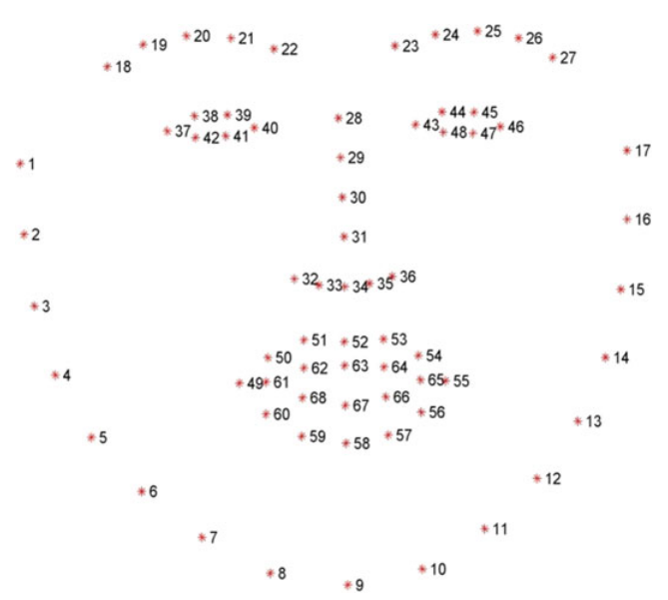
IMPLEMENTATION

Slide 11
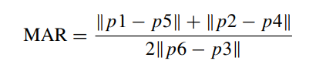
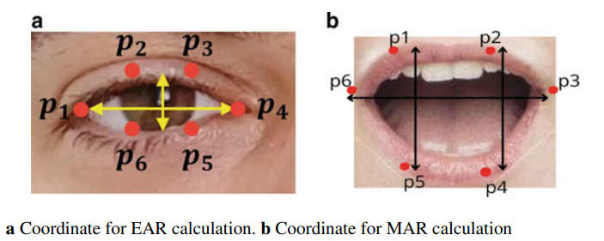
IMPLEMENTATION
As illustrated in Fig. , the feature points are labelled clockwise, getting started at the lower-left corner of the mouth. It has been discovered that the x- and y-direction coordinates are connected in some way. The MAR is the ratio of the distance between vertical mouth landmarks to the distance between horizontal mouth landmarks.When a person yawns, the gap between his lower and upper lips widens. As a result, MAR increases and at the same time as the yawn count is increased.

Slide 12
RESULT
With the generated data, the proposed system was constructed and tested. The camera
has been linked to the system so that the video streaming can be further processed and
classified online. Then the calculated values are stored for analysis and categorization
purposes. Figure 4 depicts a frame of an active state. EAR and MAR values for this
frame are mentioned below.
EAR = 0.29 MAR = 0.45
Figure 5 depicts a variety of drowsy situations. Figure 5a shows an example of the
drowsiness alert caused by eye closing, while Fig. 5b shows an example of a drowsy
situation caused by yawning.

Slide 13
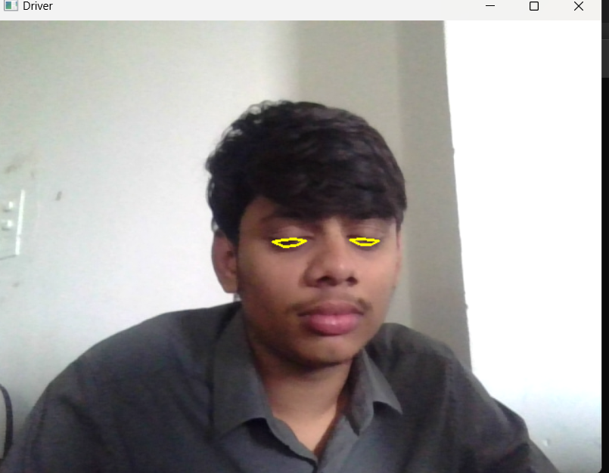
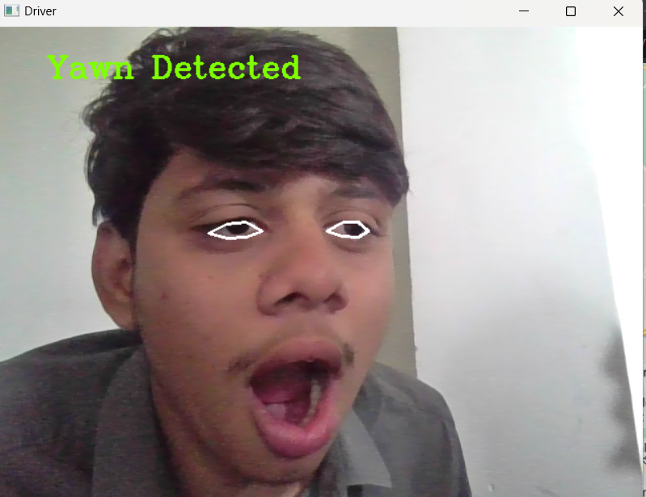
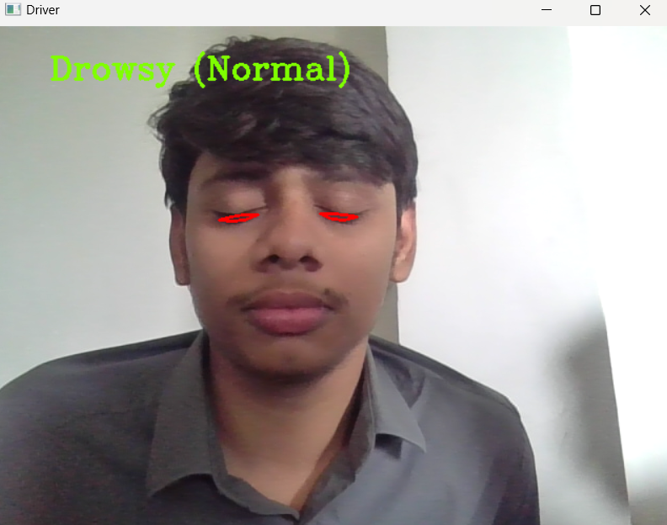
FIGURE-4
FIGURE-5(A)
FIGURE-5(B)

Slide 14
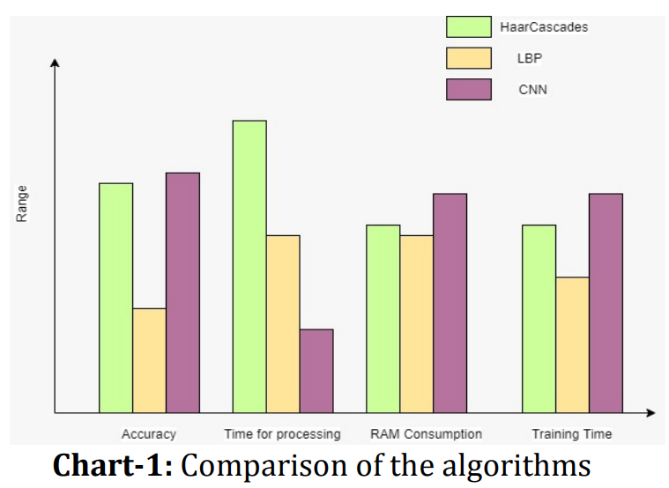
ACCURACY:
In general, the model provides good accuracy in a range of illumination and positioning conditions. It demonstrates how unworkable this system is. The other models and algorithms need a lot of components and are very complicated.

Slide 15
THANK YOU

